Slide 1
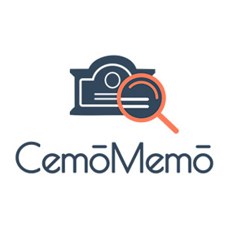
Using Generative AI to Analyze and Understand Cemetery Gravestones and Burial Culture
Michael J. May, Jamal Majadle, Libar Vizman, Netanel Shen, Efrat Kantor

Slide 2
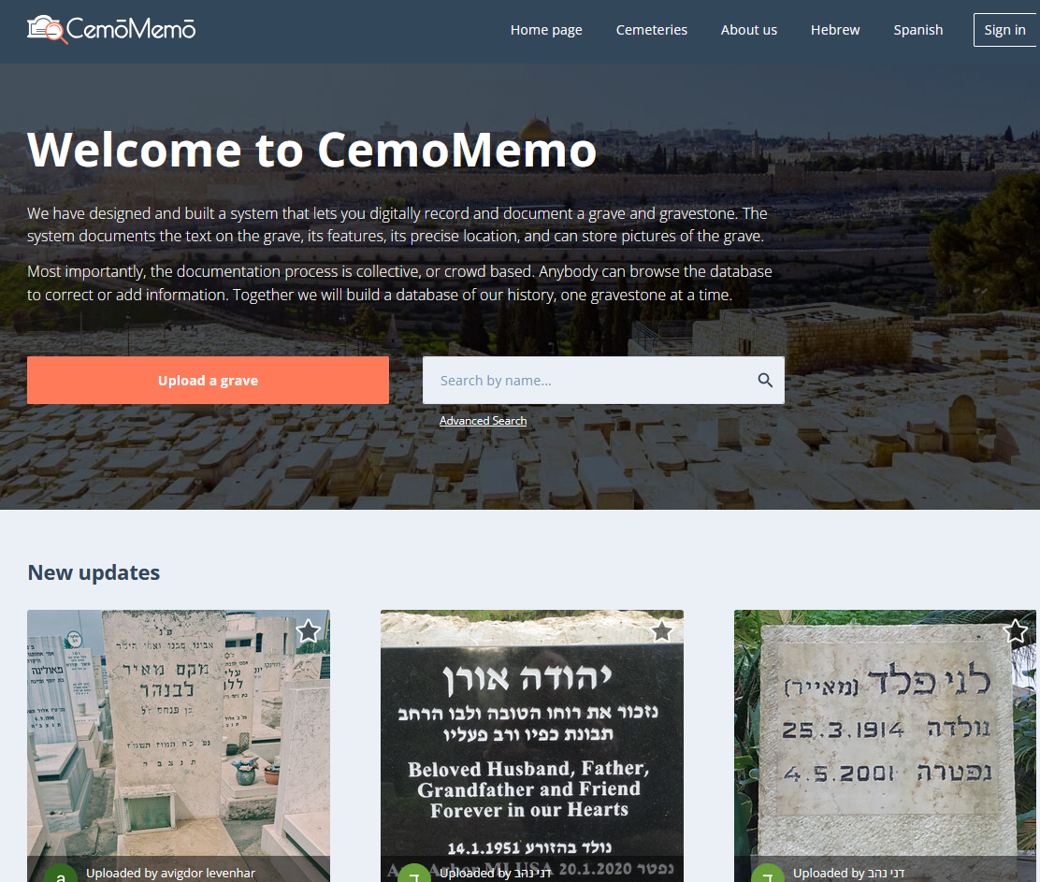

Slide 3
CemoMemo Statistics
Over 9500 gravestones
189 cemeteries
13 countries
22 languages represented
Jewish, Christian, Muslim, Druze burials
1,153 Registered Users

Slide 4
CemoMemo’s Vision
Preserve burial culture and heritage through digital documentation of cemeteries and memorials
Make burial culture and heritage available to all: families, communities, researchers

Slide 5

The gap
Online cemetery digitization systems are manual centric
Genealogy-oriented systems are good to find family, not good for burial culture and history
Adding gravestones and memorials requires manual data entry and validation
Need language expertise to read complex or worn gravestones
Understanding context and high-level aspects of burial culture is impossible without perspective
Cemeteries are “dead” – how can we bring the stories of a community to life?
Photo by Micah & Sammie Chaffin on Unsplash

Slide 6
Generative AI Tools Help
Cemetery summary generation
RAG-based conversational interface
Multi-lingual OCR + VLM Pipeline

Slide 7

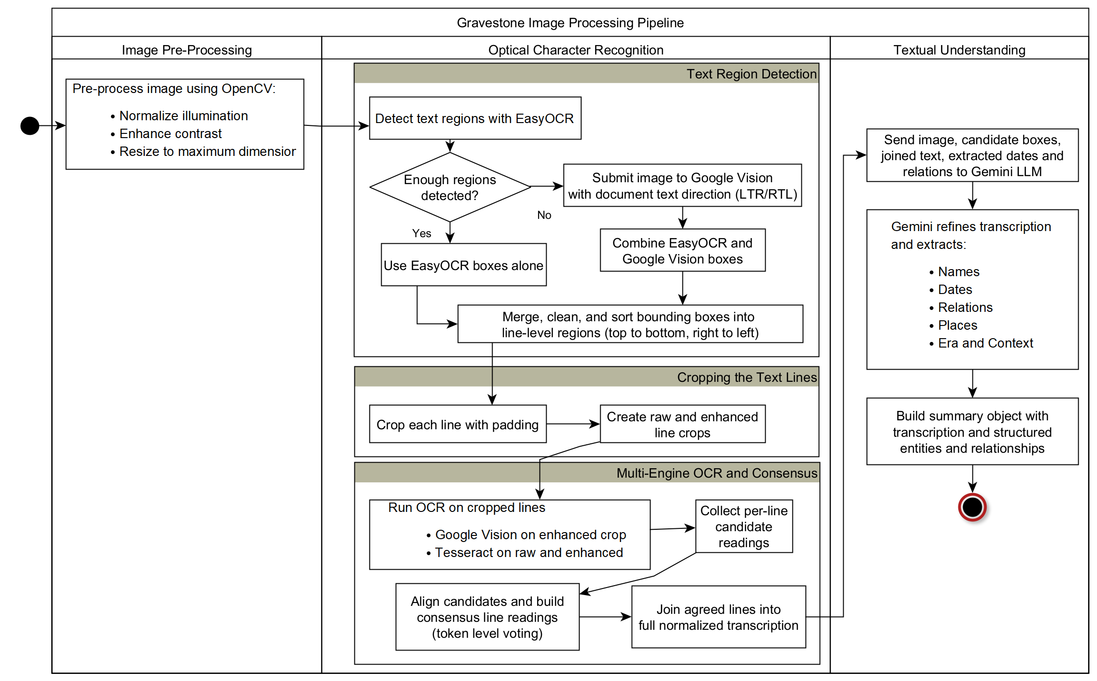


Multi-lingual OCR + VLM Pipeline
This Photo by Unknown Author is licensed under CC BY-NC-ND
This Photo by Unknown Author is licensed under CC BY-SA
This Photo by Unknown Author is licensed under CC BY-SA

Slide 8
Reading Challenges
Multiple languages
Multiple scripts
Image quality
Wear
Occlusion
Lighting
Shadows
Resolution

Slide 9
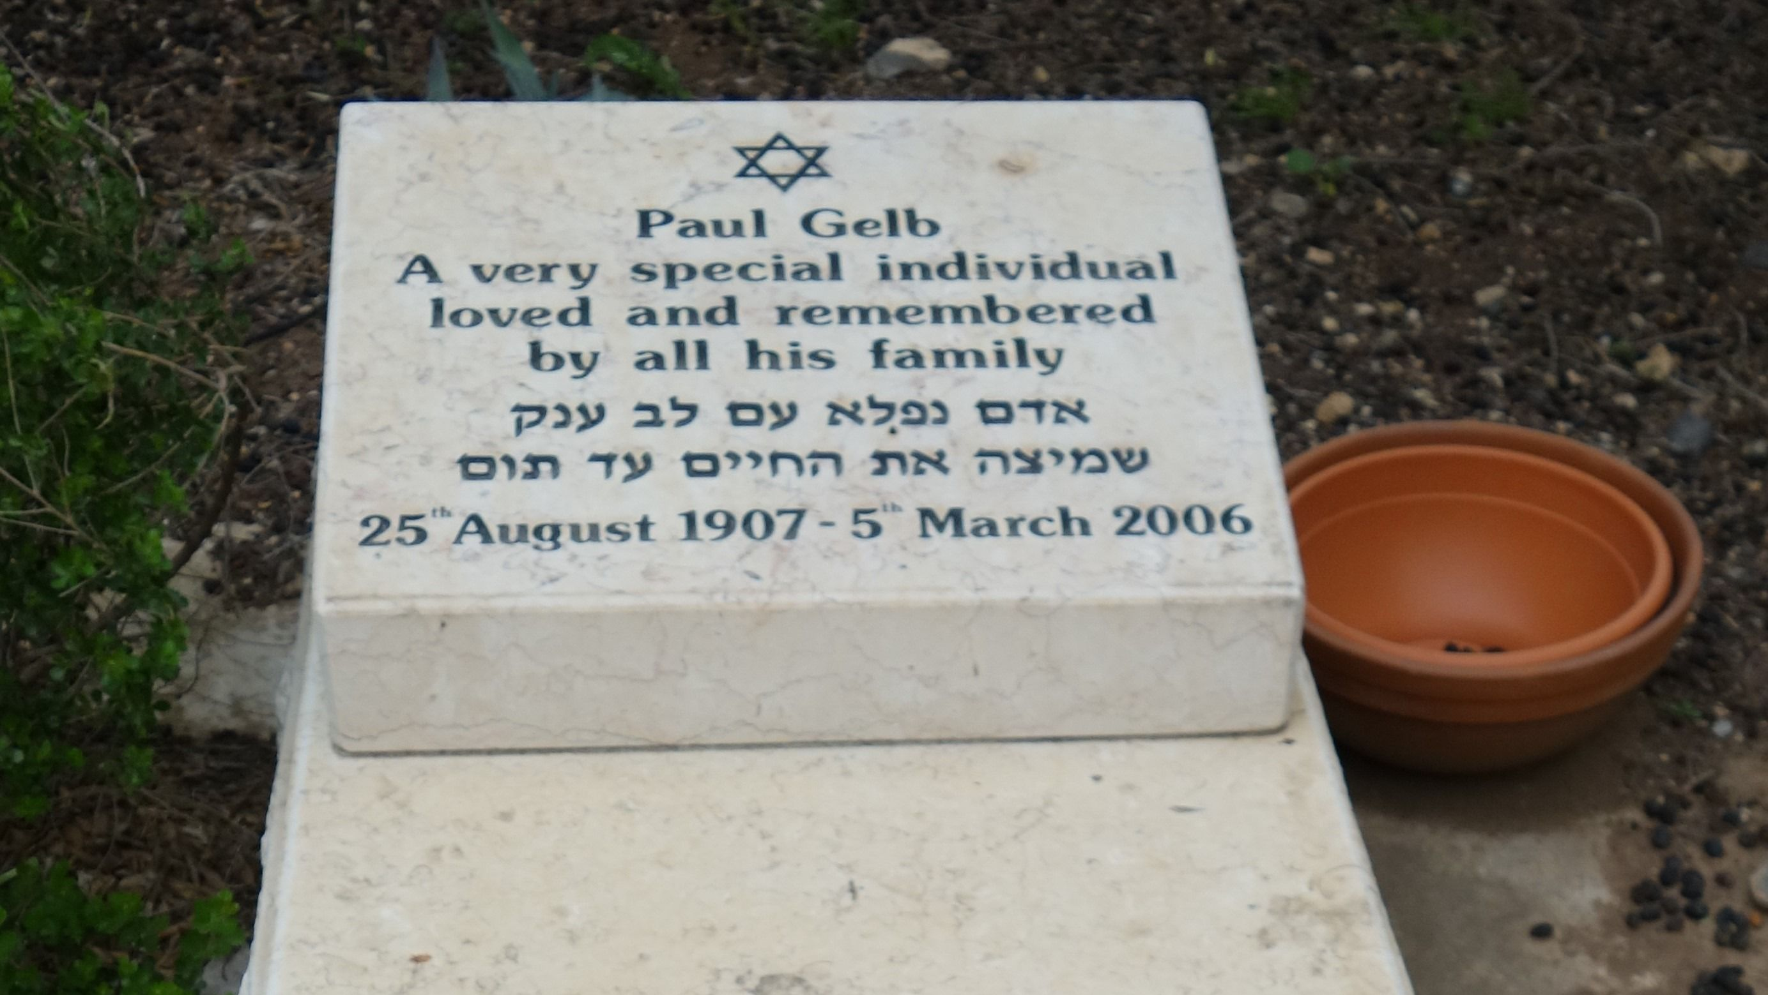
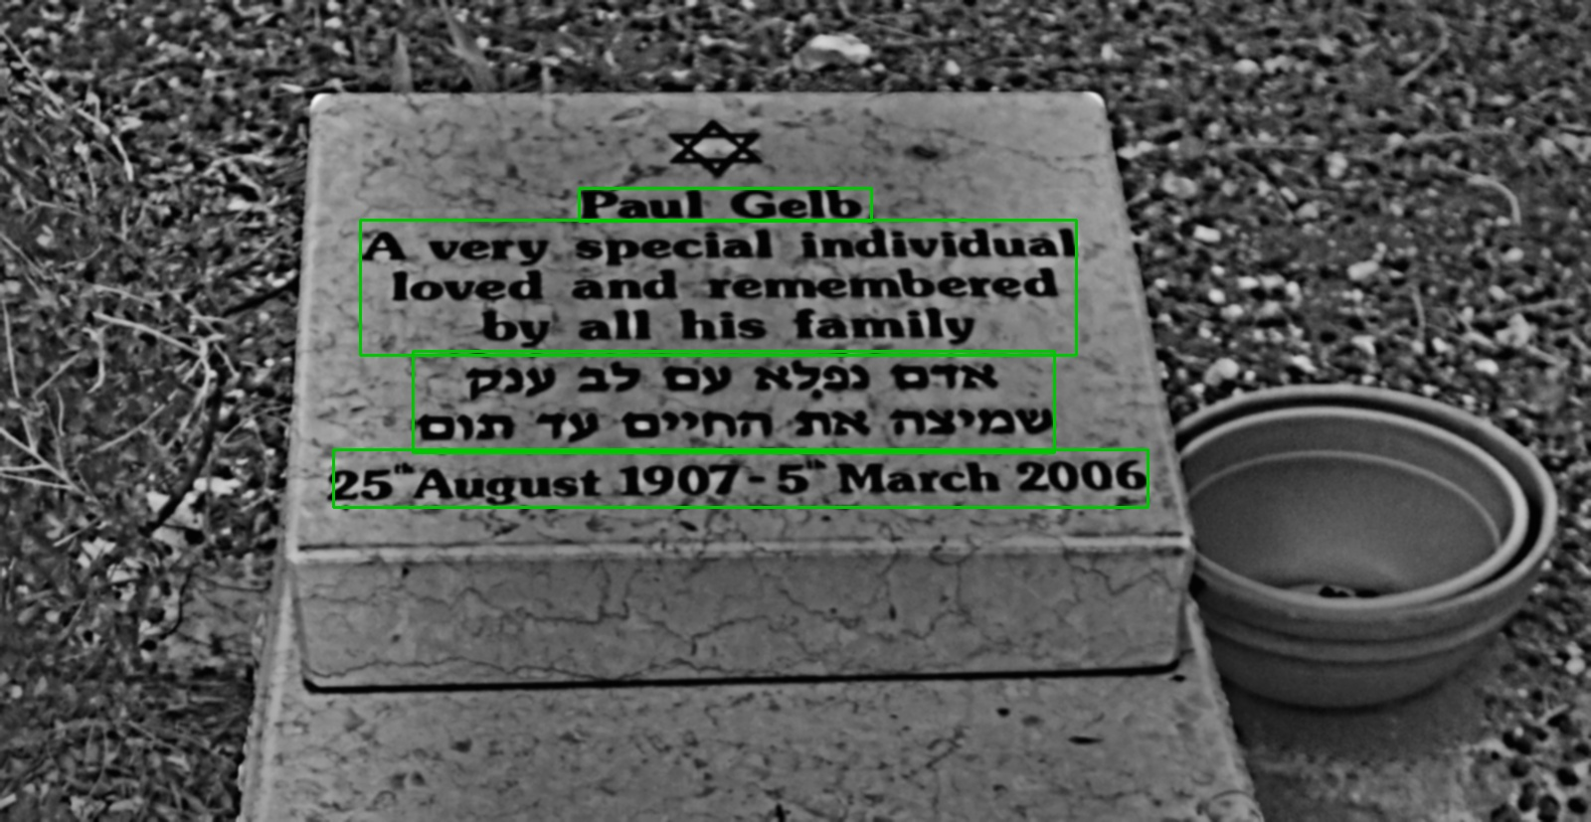
Reading Sample: Hebrew/English
Field | Value
Name | Paul Gelb
Age | 88
Birth date | 25/8/1907
Death date | 5/3/2006
Epitaph | A very special individual loved and remembered by all his family אדם נפלא עם לב ענק שמיצה את החיים עד תום | A wonderful big-hearted man, who squeezed life to the last drop
Language | HE/EN
Pipeline output: 100% successful read, 100% of fields parsed

Slide 10
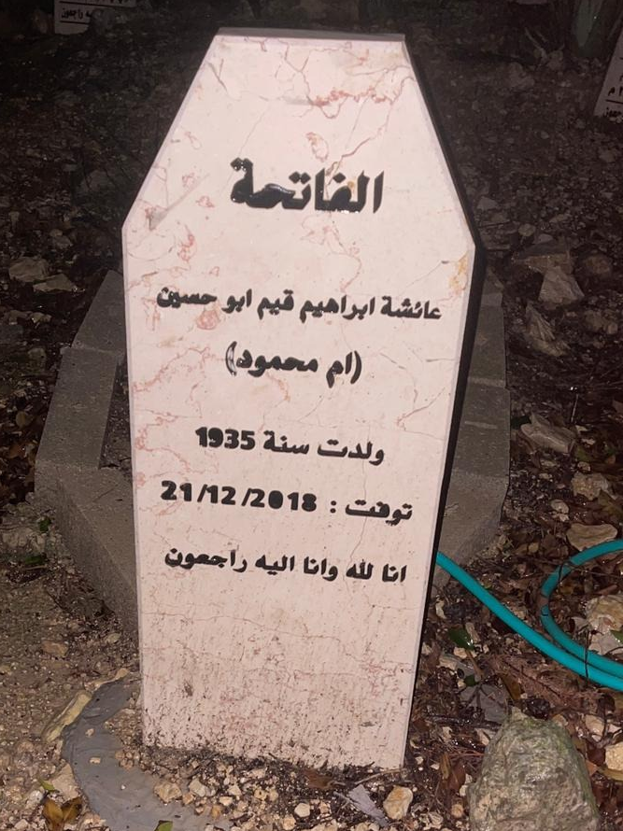
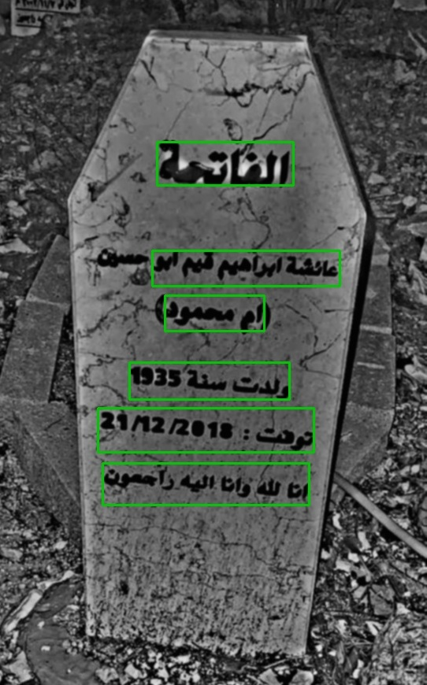
Reading Sample: Arabic/Latin
Field | Value
Name | عائشة ابراهيم قيم ابو حسين | Aisha Ibrahim Qayem Abu Hussein
Age | 83
Birth date | 1935
Death date | 21/12/2018
Epitaph | الفاتحة عائشة ابراهيم قيم ابو حسين (ام محمود) ولدت سنة 1935 توفت: 21/12/2018 انا لله وانا اليه راجعون | Al-Fatiha Aisha Ibrahim Qayem Abu Hussein (Um Mahmoud) Born: 1935 Passed away: 21/12/2018 Indeed, we belong to God, and to Him we shall return.
Language | Arabic
Pipeline output: 100% successful read, 100% of fields parsed

Slide 11
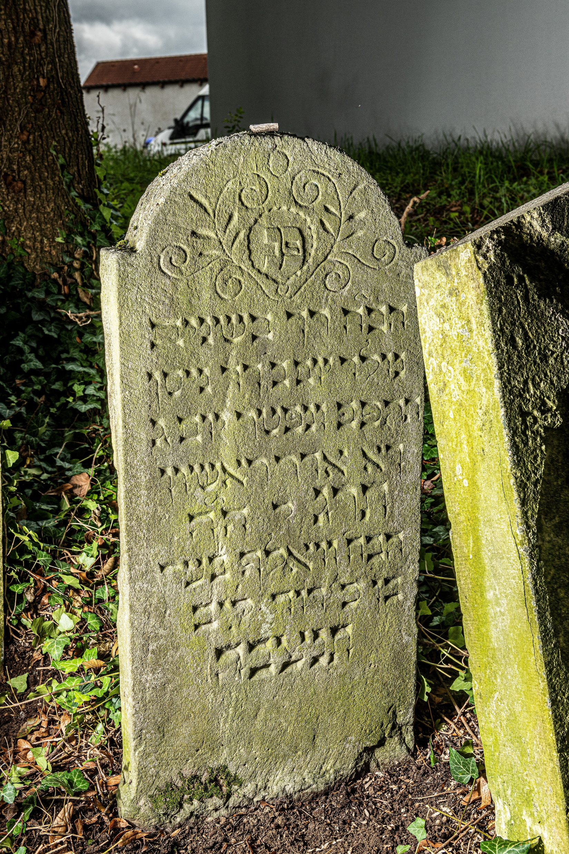
Reading Sample: Worn Hebrew
Field | Detected value | Ground truth
Name | מאיר בר שמעון גיטמן | ואלף בער
Age | (null) | 20 (implied)
Birth | (null) | ב ניסן תקפב
Death | (null) | כא אדר א תרג
Epitaph | פנ הילד רך בשנים מאיר בר שמעון גיטמן נקטף ונפטר יום בא אדר ראשון תרנה תנצבה | פנ הבח רך בשנים נולד יום ב דח ניסן תקפב ונפטר יום ג ךא אדר ראשון תרג ל הה הבח וואלף בער בן כ דוד ליב תנצבה
Language | HE | HE
Character Error Rate: 53%, Word Error Rate: 75%
What went wrong?
Script and text ordering
Angle of photography
Wear on the stone

Slide 12
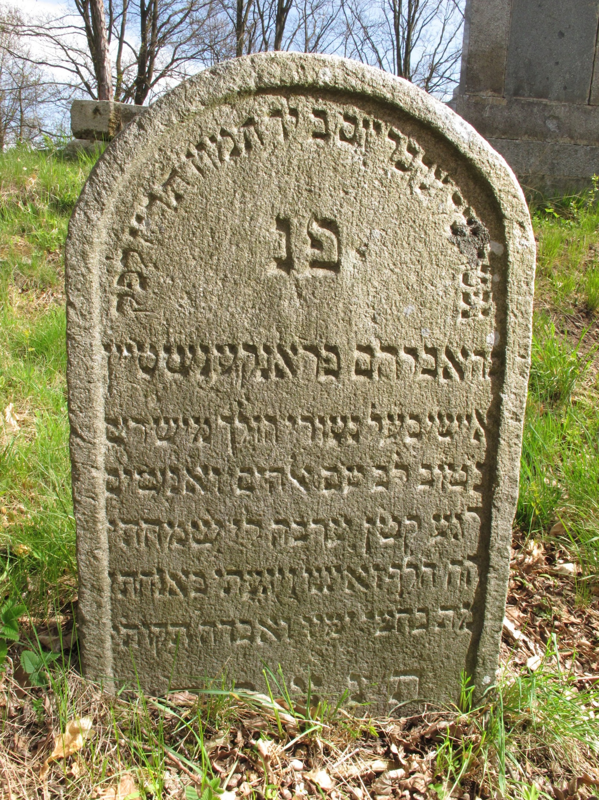
Reading Sample: Worn Hebrew
Field | Detected value | Ground truth
Name | אברהם פראנקענשטיין | אברהם פראנקענשטיין
Death | ד תמוז תרעב | יד תמוז תריז
Epitaph | נפטר יום בד תמוז תרעב לפק פנ ר אברהם פראנקענשטיין איש ישר פעלו הולך מישרים בטוב לב יהב לה ולאנשים רודף קשט עתה רבה לו שמחתו הדל ואביון יאהל באהלו מת בחצי ימיו ואבדה תקותו תנצבה | נפטר שק ונקבר יום ב יד תמוז תריז לפק פנ כה אברהם פראנקענשטיין אישי בעל נעורי הולך מישרים בטוב לב עם ﭏהים ואנשים רגע קטן ערבה לו שמחתו הה חלף ואיננו ויגעתי באנחתי מת בחצי ימיו ואבדה תקותי תנצבה
Language | HE | HE
Character Error Rate: 31%, Word Error Rate: 59%
What went wrong?
Occlusion and shadow
Wear on the stone
Textual complexity

Slide 13
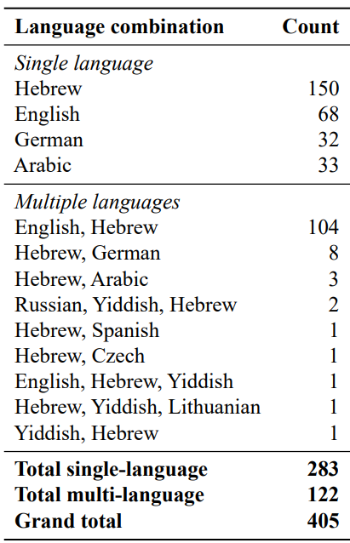
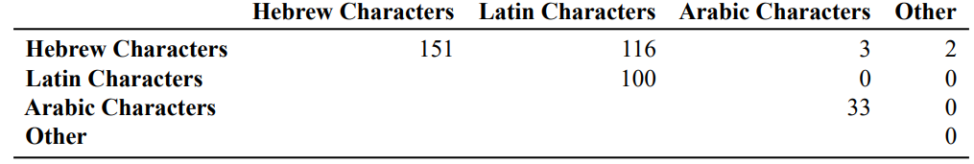
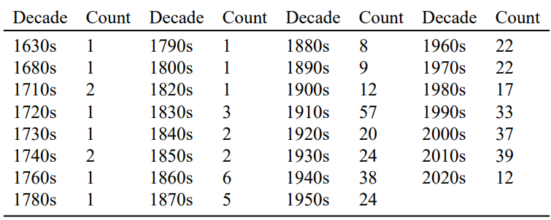
Pipeline Performance: Test set parameters

Slide 14
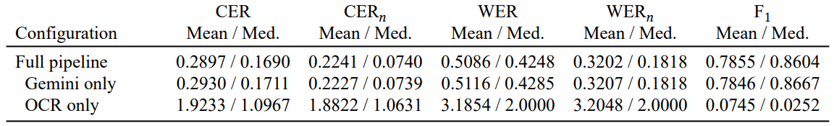
Pipeline Performance: Overall

Slide 15
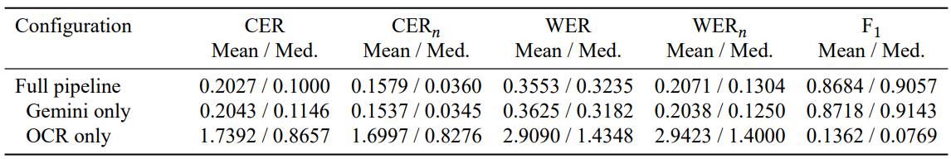
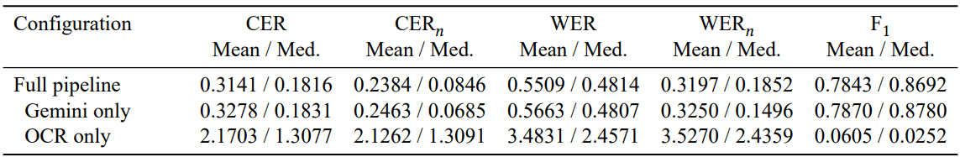
Pipeline Performance: Latin-script Only
Pipeline Performance: Multi-Script

Slide 16
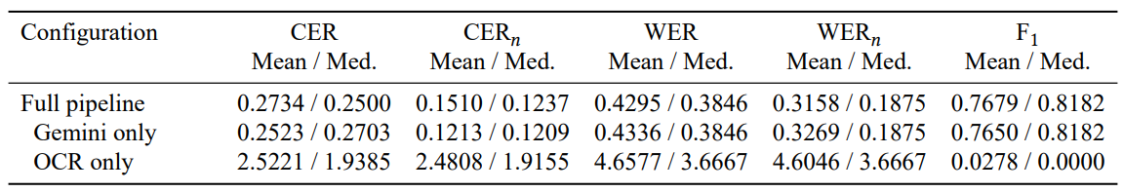
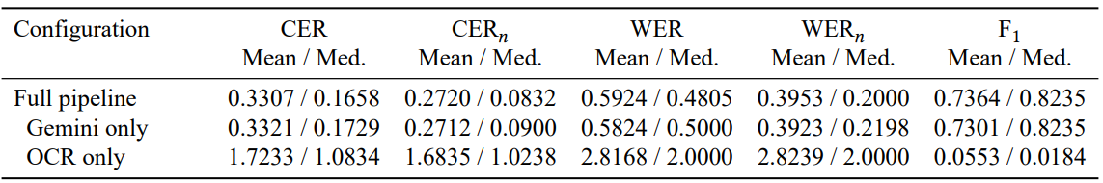
Pipeline Performance: Arabic Only
Pipeline Performance: Hebrew Only

Slide 17
Pipeline Performance: Lessons
Gemini (Vision-Language Model VLM) did most of the work
Remove VLM and performance plummets
Top of the line VLMs struggle with Hebrew, Arabic, and mixed script
We are far away from 1-2% CER/WER typical of printed Latin-script reading

Slide 18
Cemetery Level Summaries
Problem:
Goal:
Solution:
Only famous and historically important cemeteries have write ups and books
Help people explore and understand small, local cemeteries
Leverage CemoMemo’s database and images to auto-generate summaries and points of interest

Slide 19
Cemetery Level Summaries
Burial statistics
Historical summary
Notable people identification
How many burials?
What years?
Symbols used
Social attributes: military, family, social connections, employment
Generate tour-guide level summary based on database information
Look for trends and patterns over time
Authority control sources: Wikidata, Wikipedia, National Library of Israel
Notability criteria: site links, title

Slide 20
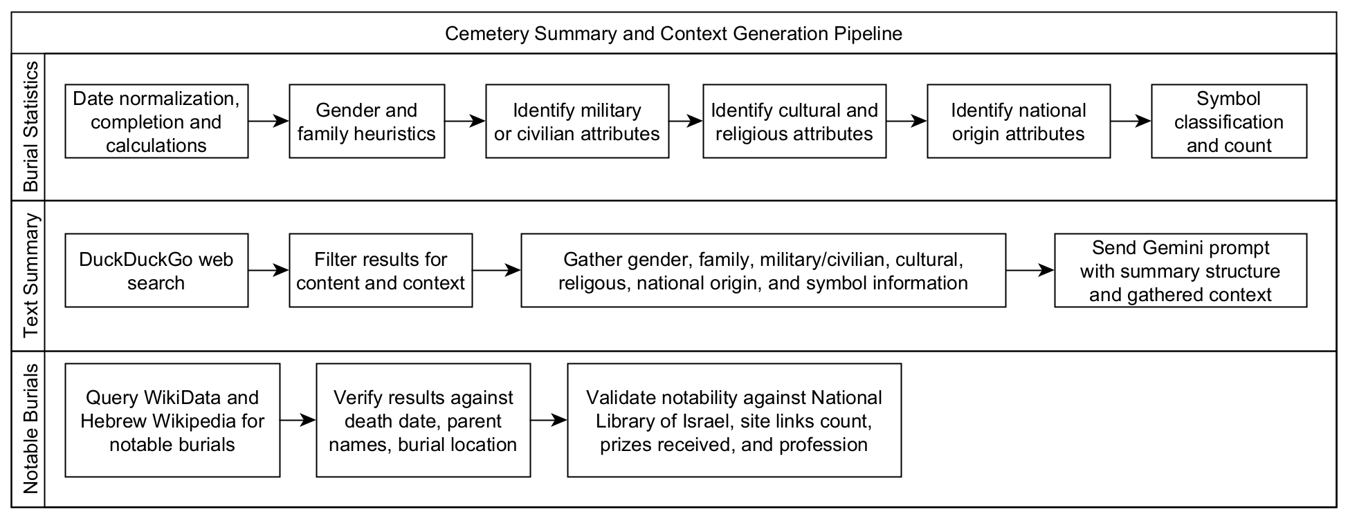
Cemetery Level Summaries

Slide 21
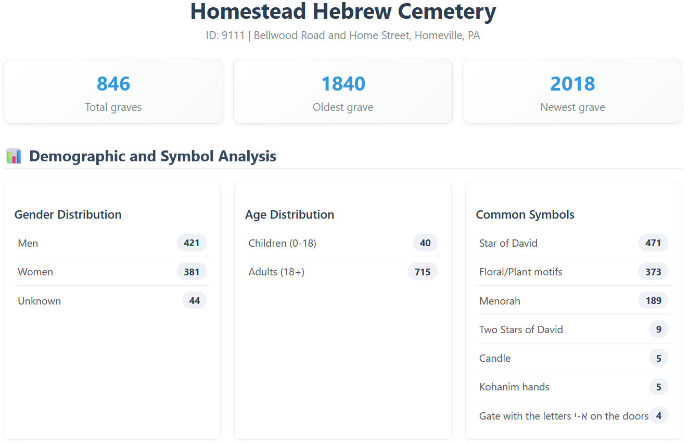
Samples: Homestead Hebrew Cemetery

Slide 22
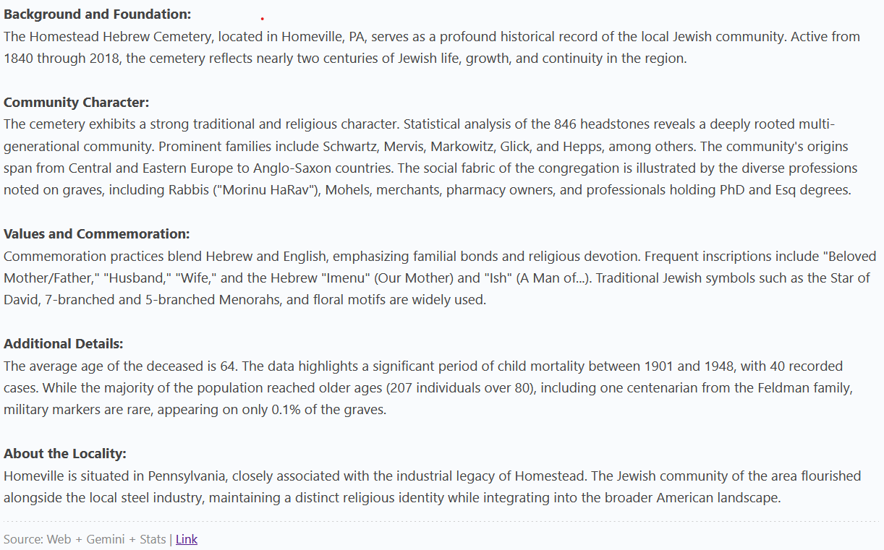
Samples: Homestead Hebrew Cemetery

Slide 23
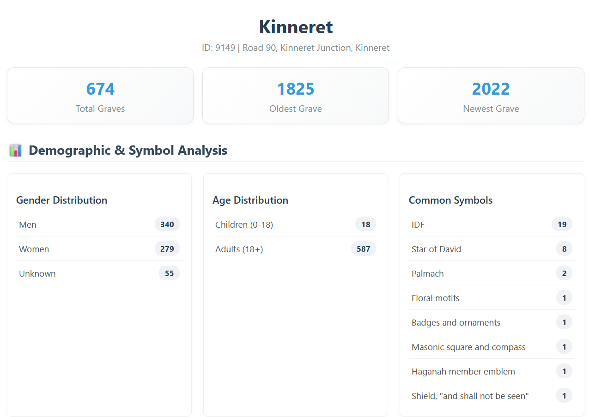
Samples: Kinneret Cemetery

Slide 24
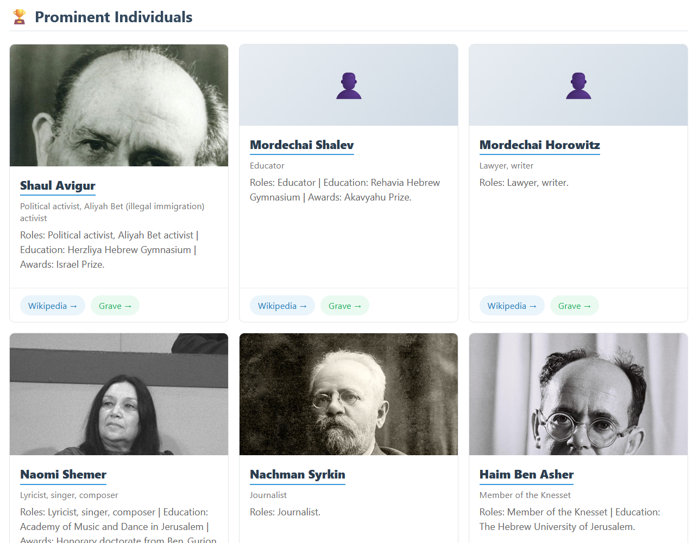
Samples: Kinneret Cemetery

Slide 25
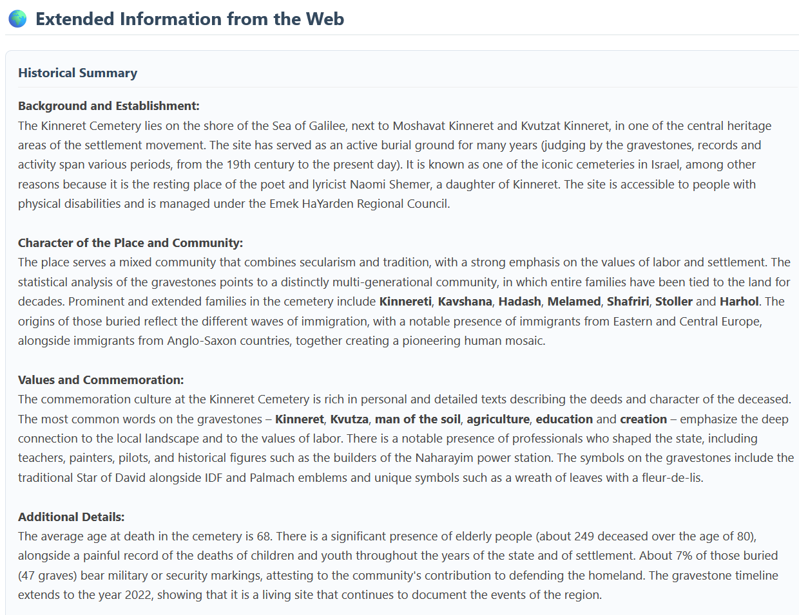
Samples: Kinneret Cemetery

Slide 26
Conversational Interface
“Talk” to the cemetery system
Receive answers about specific cemeteries and their history
Retrieval Augmented Generation (RAG) to reduce hallucinations
Learn about burial culture, trends, and tour-guide level information

Slide 27
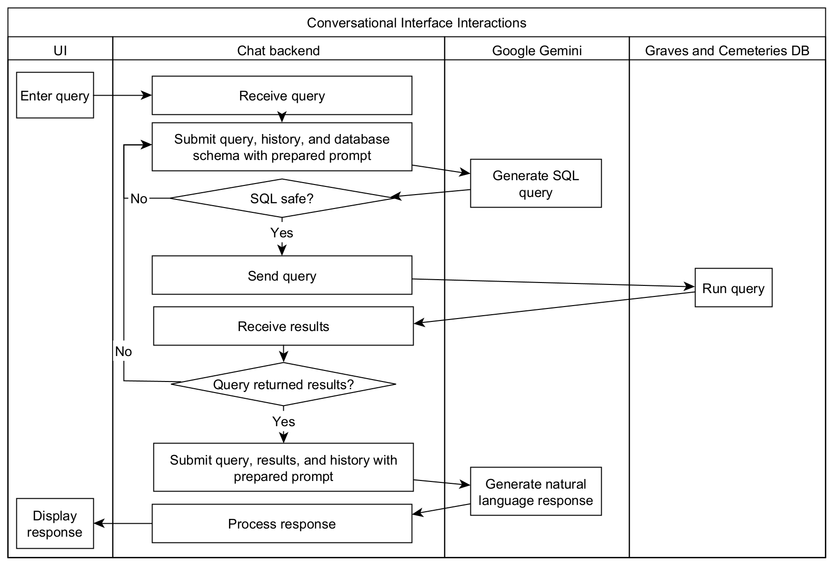
Conversational Interface

Slide 28
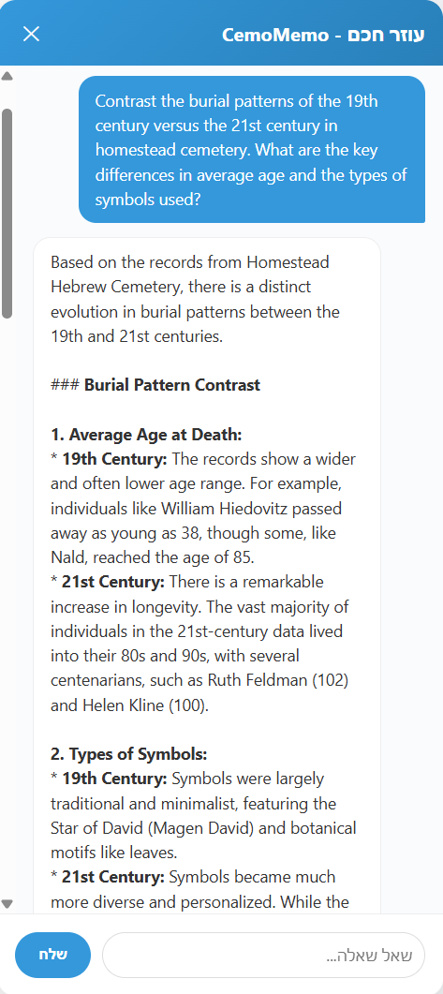
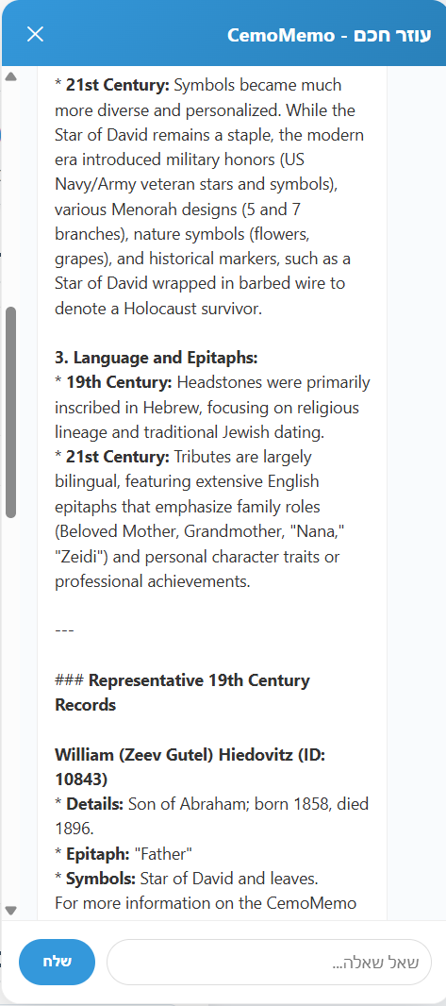
Conversational Interface: Samples

Slide 29
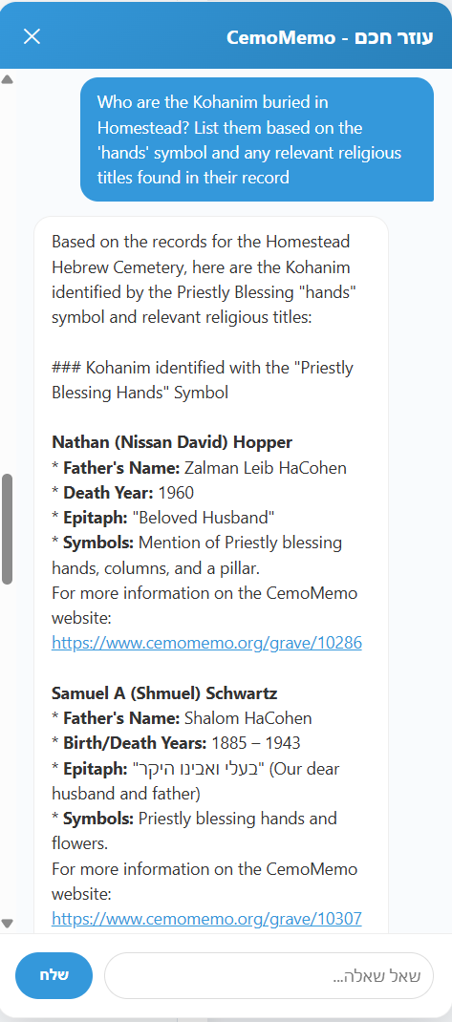
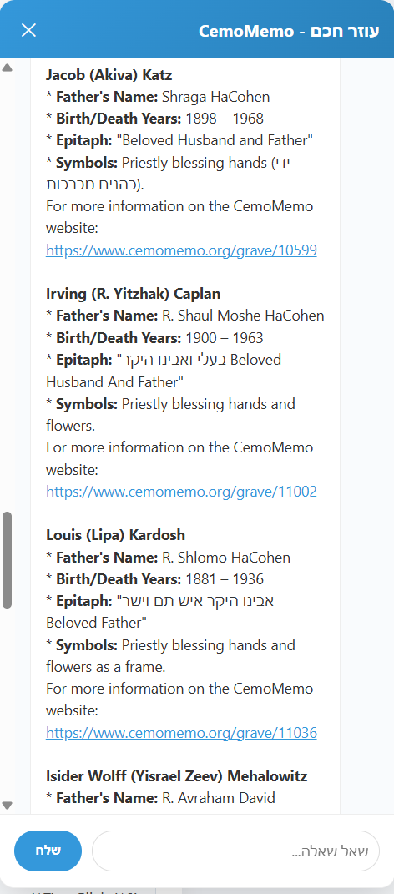
Conversational Interface: Samples

Slide 30
Summary
Bring cemeteries to life through application of GenAI
Automation brings new features with minimal human effort
Issues remain on image recognition, hallucination, and false matches
OCR integrated into production CemoMemo
Summaries and chatbot not yet released

Slide 31
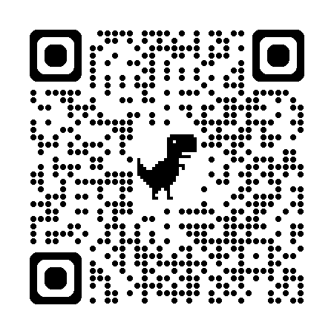
Thank you!
Michael J. May
mjmay@mx.kinneret.ac.il
CemoMemo Project
www.cemomemo.org

