Slide 1
Canonical Digests for Compressed Archives
Michael J. May and Saed Kezel
Kinneret College on the Sea of Galilee

Slide 2

About Compressed Archives (Solid)
Archive.tar.gz / Archive.7z
dir1
a
b
c
Compress and archive
File and Directory Metadata
dir2
d
e
Binary compressed data (Huffman, LZMA, etc.)

Slide 3
About Compressed Archives (Non-Solid)
Archive.zip
dir1
a
Compress and archive
File and Directory Metadata
b
c
Binary compressed data
dir2
Binary compressed data
d
e
Binary compressed data
…

Slide 4

Compression and Archives Are Everywhere
Download a repo from GitHub
Download photos from Google Photos
Download Email using Outlook
Create an MS Word or ODT Document
Download code project from Apache Software Foundation
Web protocols (QUIC, HPACK) compress files and headers

Slide 5
Related work
Compression techniques:
  Compression only: DEFLATE (Deutsch, 1996), zStandard (Collet and Broukhis, 2018), LZMA (Pavlov, 2024)
  Archive compression: ZIP (PKWARE, 2022), 7ZIP (Pavlov, 2025)
  Layered Compression: TAR/GZ, TAR/XZ
Differencing compressed archives:
  Delta++ (Samteladze and Christiansen, 2014), Donag (May, 2022), Diffoscope (Lamb and Zacchiroli, 2022)
Canonicalization:
  Canonical XML (Boyer, Marcy, Datta, and Hirsch, 2013)
File byte and block level similarity forensic tools:
  ssdeep (Kornblum, 2006), tlsh (Oliver, Cheng, and Chen, 2013), lzjd (Raff and Nicholas, 2018)

Slide 6
Compressing data saves space and bandwidth
at the cost of
compute cycles

Slide 7
Compressed Archives are Seen as Files,
Not File Systems
Opaque to OS search and archiving
Can’t Read or Write inside natively via OS
Adding/Removing files from the archive changes the on-disk byte representation
No easy way to tell if two compressed archives are equivalent
Compressing with different entry order, different tools, or different compression level yields different on-disk byte representation

Slide 8
Goals of canonical digests for compressed archives
Acknowledge compressed archives are file systems
Format agnostic content and metadata summary for offline and remote comparison
Enable intelligent comparison of content identity and metadata identity
Ignore archive and compression details
Archive format, compression algorithm, and entry order must be transparent/irrelevant

Slide 9
Why is this tricky?
Why not use the SHA-2/SHA-3 archive digest?
Hash uses on-disk byte representation that depends on many factors
Isn’t the archive per-file metadata enough?
Zip identical sets of files twice with the same tool and you’ll get different results
Want to be format agnostic
Each archive format has different metadata
Some archive formats lack standards or support extensions

Slide 10
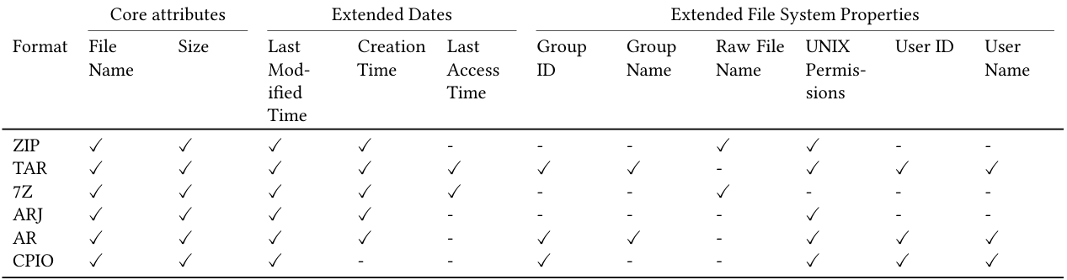
Compressed archive metadata fields support.
TAR and CPIO are archive-only formats commonly paired with other compression algorithms such as GZIP, BZIP2, and zStandard.

Slide 11
Why is this tricky?
Can file similarity tools help?
Existing tools (e.g., tlsh, diffoscope, lzjd, ssdeep) are built for malware analysis and forensics
Compressed archives are high-entropy, so most fail to find any similarity
Tools that support compressed archives give a score of similarity, but don’t give more detail

Slide 12
How the Canonical Digest Algorithm Works
30,000 Foot View
Drilling to Details
Lexicographically sort entries
Compute digest (e.g. SHA-256) for file names + content in order
Compute a digest for every metadata field present in order
Output all present digests and label them
Everything is optional
  Anonymous entries
  Entries without content (e.g. dirs)
  Some entries might be missing metadata fields
Delimit file names, content, metadata fields
Standardize formats, encodings, byte order

Slide 13
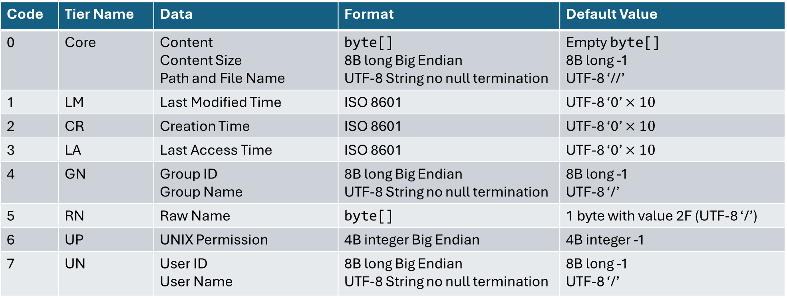
8 Digest Tiers (Dimensions)
Code | Tier Name | Data | Format | Default Value
0 | Core | Content Content Size Path and File Name | byte[] 8B long Big Endian UTF-8 String no null termination | Empty byte[] 8B long -1 UTF-8 ‘//’
1 | LM | Last Modified Time | ISO 8601 | UTF-8 ‘0’ $×10$
2 | CR | Creation Time | ISO 8601 | UTF-8 ‘0’ $×10$
3 | LA | Last Access Time | ISO 8601 | UTF-8 ‘0’ $×10$
4 | GN | Group ID Group Name | 8B long Big Endian UTF-8 String no null termination | 8B long -1 UTF-8 ‘/’
5 | RN | Raw Name | byte[] | 1 byte with value 2F (UTF-8 ‘/’)
6 | UP | UNIX Permission | 4B integer Big Endian | 4B integer -1
7 | UN | User ID User Name | 8B long Big Endian UTF-8 String no null termination | 8B long -1 UTF-8 ‘/’

Slide 14
FAQ
Why not have a tier for (fill in the blank)?
What if an archive has no values for a tier?
What about nested archives?
Go ahead, just define it and make it #8, #9, #10, etc.
Skip it in the canonical digest output, it’s just a meaningless default value
We don’t recurse, but you could add another tier for that
Why those 8 tiers?
They’re the metadata fields supported by Apache Commons Compress library

Slide 15
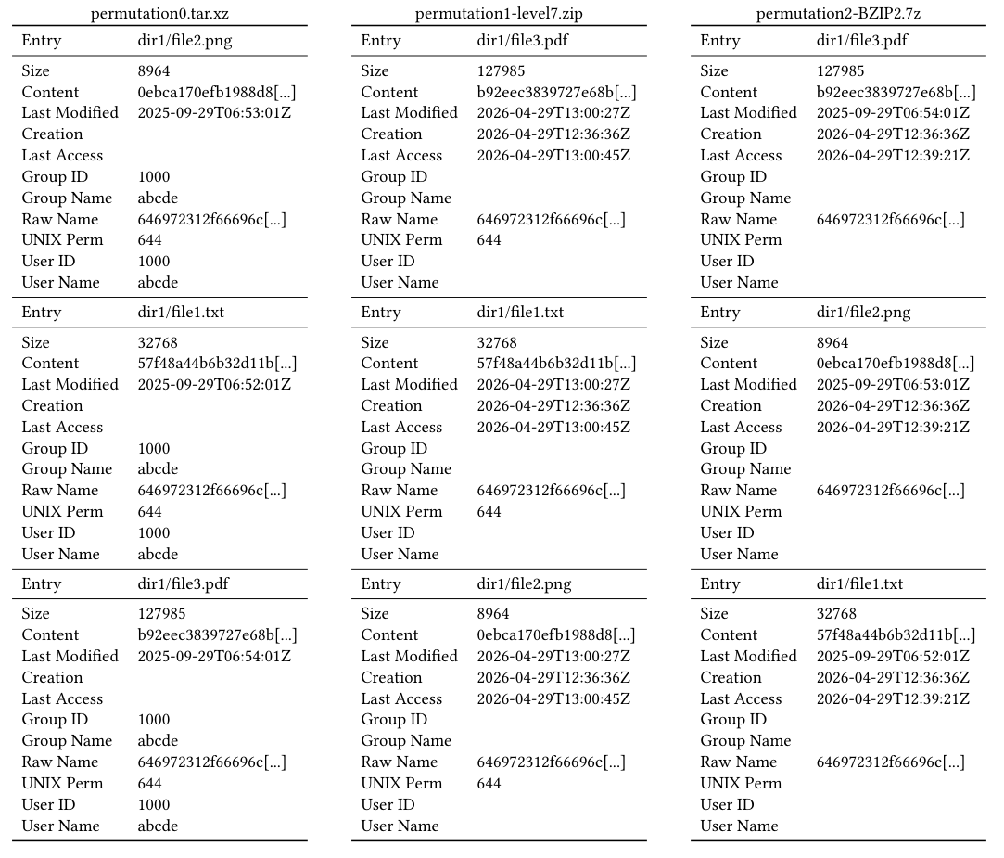
Made in Ubuntu
TAR/XZ and ZIP have standard UNIX file permission
Made in Windows 11
3 Identical files
Raw names identical
Last Modified Time and Last Access Time not uniform
Creation time shared between ZIP and 7Z/BZIP

Slide 16
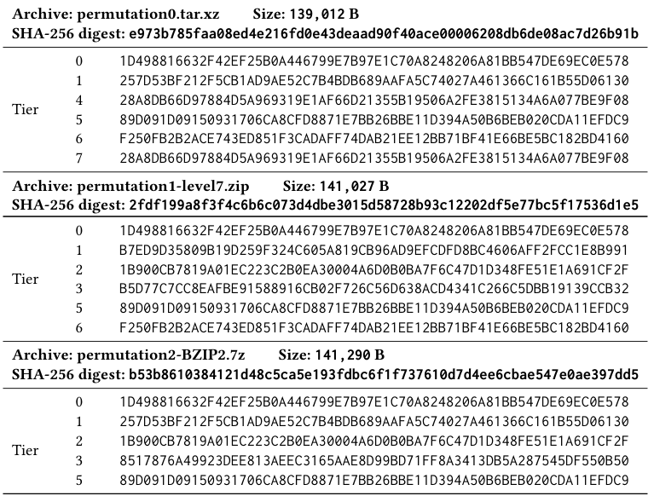
Applying Canonical Digest Algorithm

Slide 17
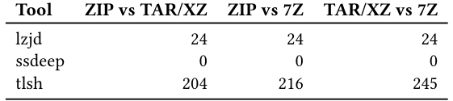
Trying the same comparison using existing tools
lzjd: 0 = identical, 100 = totally different
ssdeep: 0 = different, 100 = identical
tlsh: 0 = identical, larger = more different

Slide 18
Are the files the same? Depends to whom
Simple or Home User
Forensic/Metadata Investigator
Tier 0 is identical between them, so “Yes, they are identical”
After decompression, any file operation performed on one archive will work identically on the other
Significant differences here
Time stamp differences show ZIP file was accessed after
Creation time not consistent
File owner and permission not uniform after decompression

Slide 19
Applications and Potential Uses
Dynamic content downloading deduplication
Content Addressable Storage
Remote File System Attestation
Flexible Integrity Check
Forensic Similarity
Compute digests on the content
Before downloading, send digests with HTTP HEAD
Mirrors with different compressed versions
Let multiple compressed versions with similar or identical digests be mirrors of each other
Need to select which tiers to use
Security?
Describe a local file system using the tiers, sign, submit to validator
If right tiers are OK, system approved
Digitally sign the tiers
Let any compressed version download and verify based on them
Security?
Another tool alongside tlsh, ssdeep, lzjd, etc.
Specific to compressed archives
Can’t take blocks from differently compressed archives

Slide 20
A word about security:
How easy is it to find/construct tier collisions?
UNIX Permission
Creation, Modification, Last Access Times
User and Group
Raw name
Core
Harder
Easy
Target: Constructing a Core collision must be as hard as constructing a collision for the underlying hash algorithm
(Work in progress)

Slide 21
Performance analysis: Test Set
384 archives, synthetic and downloaded
Sizes: 32KB to 7MB
Formats
Contents: 2 – 1,290 entries
7Z/BZIP2, 7Z/COPY, 7Z/DEFLATE, 7Z/LZMA
AR, ARJ, CPIO
TAR/BZIP2, TAR/GZ, TAR/XZ, TAR/ZST
ZIP/DEFLATE

Slide 22
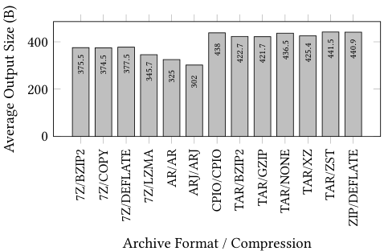
Performance Analysis: Digest Size

Slide 23
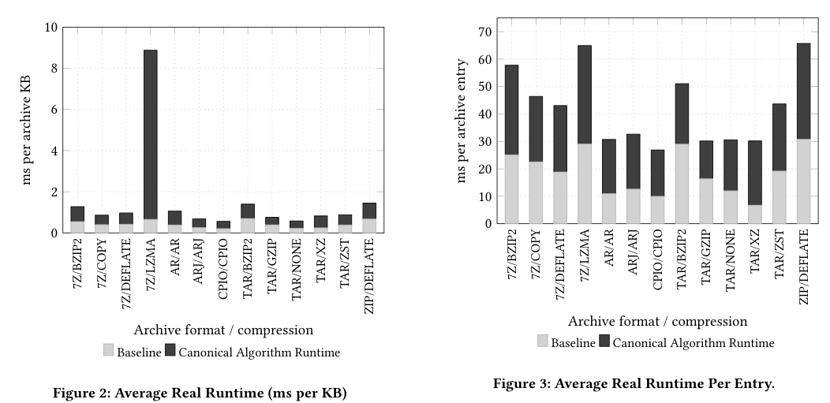
Performance Analysis: Runtime

Slide 24
Future work
Security analysis
Testing at scale
Dynamic download deduplication
Digital signatures
Extension tiers
Collisions and false positives
Apply the algorithm to entire file systems
Runtime, memory usage, performance
Extend MetaLink to support digests
Check digests before downloading
Apply to downloadable content that may be repacked (e.g. APKs, Installer packages)
Sample: ignoring shared prefixes for GitHub, SourceForge, and Apache downloads

Slide 25

Questions and Collaborations
We’d love to hear from you with ideas for integration, collaboration, or security analysis
Michael J. May
mjmay@mx.kinneret.ac.il
https://mjmay-kinneret.github.io/

